Slide 1
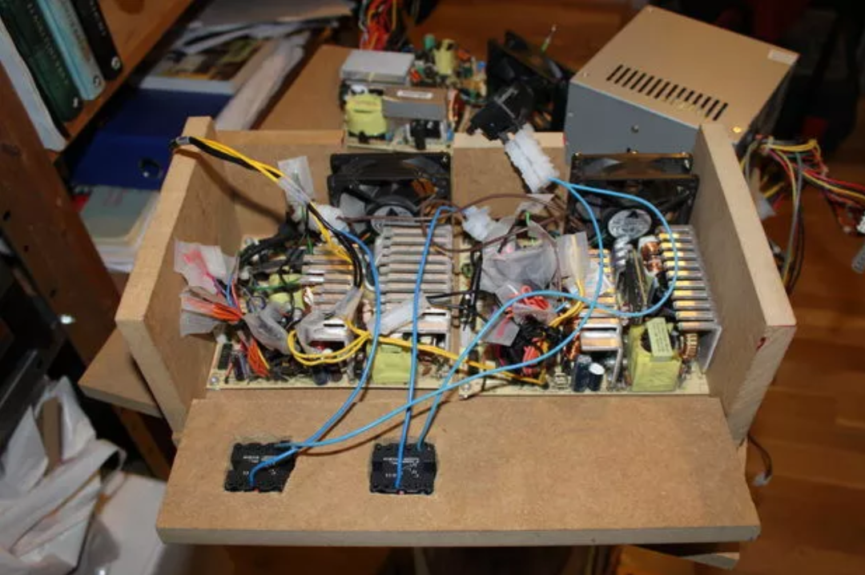
Power Supplies 101 AC-DC Converters
3-Feb-2018

Slide 2

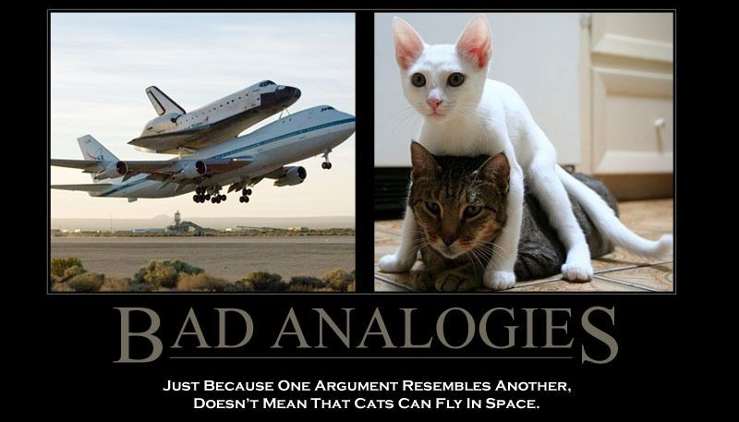
Rules of thumb, assumptions and mixed-quality analogies to come!

Slide 3
Tonight’s Agenda AC-DC Supplies
Tonight’s theory will help you understand:
Classical AC-DC linear supplies
How they work
Component selection, supply design
Switch mode AC-DC linear supplies
How they work at a very high level
Switching vs linear trade-offs
Tonight’s lab:
Power up a switch mode AC-DC supply
Build a linear AC-DC power supply
Use an oscilloscope to measure AC and DC waveforms
Measure load regulation
Next week:
How regulation loops work
More detail on how switch mode supplies work
How 3-terminal linear regulators work and wire some up
Use some DC-DC switching supplies

Slide 4
Voltage
A power supply provides a constant voltage to its load at all times
Voltage rating of supply must be equal to what the load requires
If the load needs 5V then the supply must be rated at 5V
The load draws however much current it needs, this varies with time
An audio amp draws more current when a loud signal is being played than when a quiet signal is being played
A blinking LED circuit draws more current when the LED is illuminated
Supply current rating must be larger than or equal to what the load needs. A 1 million amp power supply will work with a load that only needs 1 amp
+
+
I_{LOAD}
Load
V_{SUPPLY}
V_{LOAD}
-
-

Slide 5
Voltage, Current and Power Supplies
A power supply provides a constant voltage to its load at all times
Voltage rating of supply must be equal to what the load requires
If the load needs 5V then the supply must be rated at 5V
The load draws however much current it needs, this varies with time
An audio amp draws more current when a loud signal is being played than when a quiet signal is being played
A blinking LED circuit draws more current when the LED is illuminated
Supply current rating must be larger than or equal to what the load needs. A 1 million amp power supply will work with a load that only needs 1 amp
+
+
I_{LOAD}
Load
V_{SUPPLY}
V_{LOAD}
-
-

Slide 6
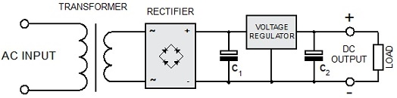
Classic AC to DC Linear Supply
Unregulated Linear AC-DC
Regulated DC-DC
Efficiency ~90-95%
Efficiency ~80%
50-80% efficient
An unregulated linear AC-DC supply is fairly efficient, 75%
An unregulated linear AC-DC supply might be a fast off-the-shelf option
A regulated linear AC-DC supply is typically 40-60% efficient

Slide 7
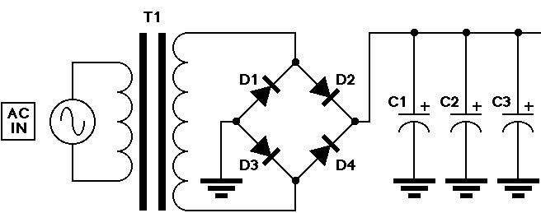
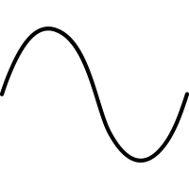
How does an unregulated linear work?
12V
V
V
V
time
time
time
120VAC RMS
170V peak
340V peak-peak
12VAC RMS
17V peak
34V peak-peak
~16VDC no load
~11V full load
~30% drop is typical

Slide 8
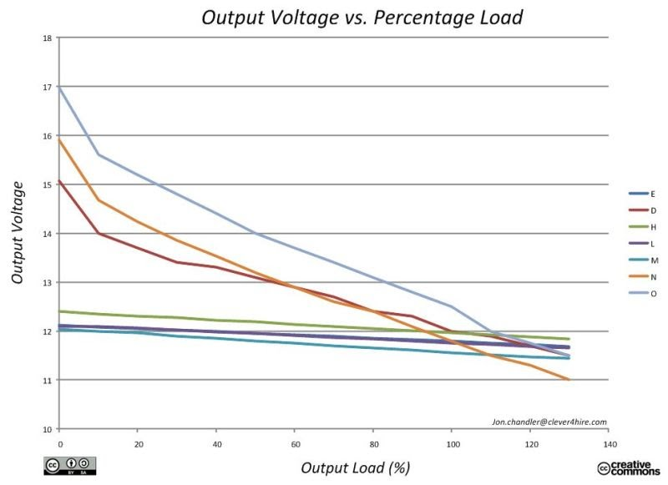
Unregulated vs regulated behavior
Common unregulated linear supplies
Common regulated supplies (these happen to be switchers)

Slide 9
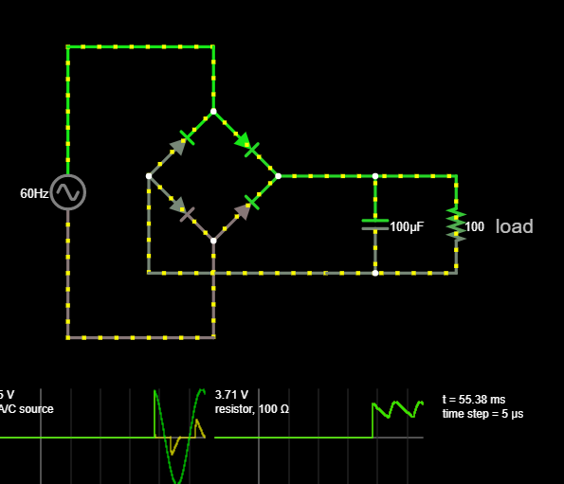
Bypass/Decoupling Capacitors
See simulations

Slide 10
Component Selection
120VAC to 5V 1A DC supply:
Transformer:
120V
5V x 1.1 + 5.2 = 10.9V -> 12V
1A x 1.8 = 1.8A
10.9V x 1.8A = 19.6VA
Rectifier diodes:
12V x 2.5 = 30V
1A x 2 = 2A
Filter capacitors:
1A / 100 = 0.01F or 10,000µF
Transformer:
Primary voltage = Wall voltage
Secondary voltage = V_{DC} x 1.1 + 5.2
Secondary current = I_{DC} x 1.8
Volt Amp rating = V_{DC} x I_{DC}
Rectifier diodes:
Peak Inverse Voltage > 2.5x transformer’s rated secondary
Maximum average current rating > 2x the DC current required
Filter capacitors
C ~= I_{DC}/(60xV_{RIPPLE})
or C ~ I_{DC} / 100 for 1.6V ripple

Slide 11
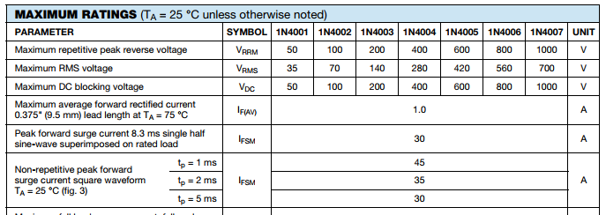
Workhorse Components
Transformers:
Scavenge from old electronics, wall warts, ebay
Tend to be expensive to buy new.
Diodes:
1N400x family
Capacitors
Will be electrolytic type to achieve required large value of capacitance
Can scavenge but be wary of older parts, electrolytics degrade over time
A small cap, 0.1uF or so is sometimes used to filter high frequency noise

Slide 12
AC-DC Switch Mode Supply
DC-DC switching supply
Rectify to DC
Generate a different AC waveform
Rectify or filter to DC

Slide 13
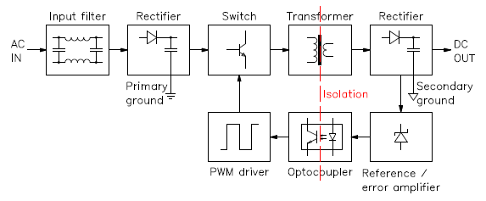
A little more detailed view

Slide 14
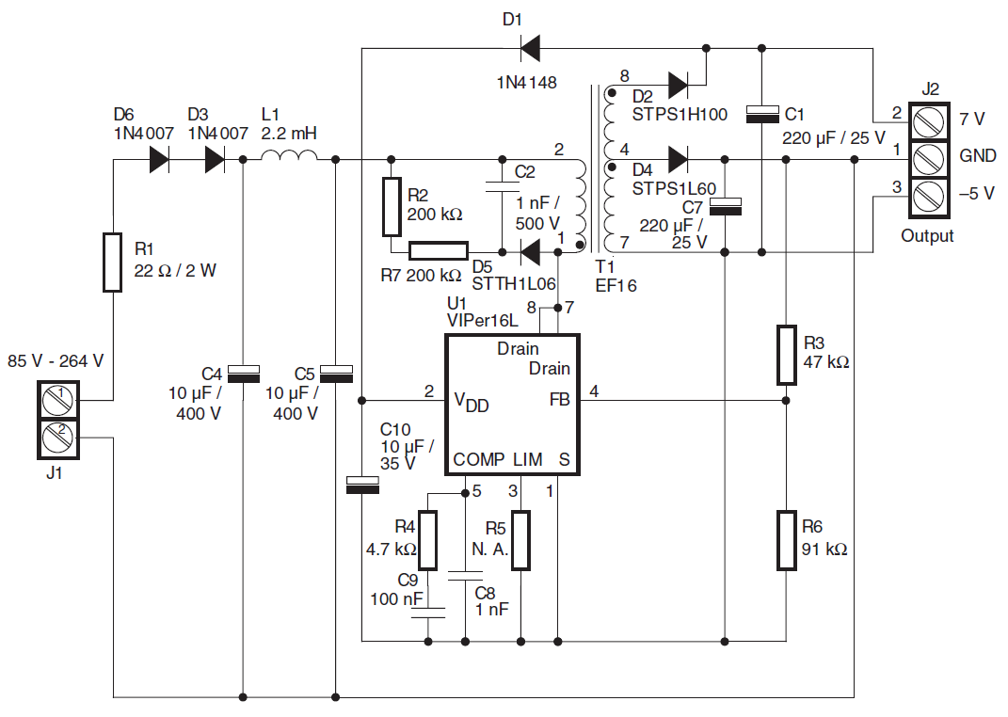
The real deal

Slide 15
AC-DC type, 2.5A class linear vs switching supplies
 | Why Build | Why Use Off the Shelf
Switching (Regulated) | “I want to learn about AC-DC switching supplies” A big project in its own right >$20 | “I just want power” Small Easy Efficient $10
Linear Regulated | “I want to learn about AC-DC linear supplies” “I have the parts laying around” Free to $20 | “I already have one” “Switchers are noisy” Hard to find Free - $50?
Linear Unregulated | “I want to learn about AC-DC supplies” “I have the parts laying around” Don’t care that output voltage varies a lot (e.g. 11-17V) Free to $20 | “I already have one” “Switchers are noisy” Some wall warts Free - $10

